Slide 1
Applied Data Science Exploratory Data Analysis
Dr. Omri Allouche
2017

Slide 2
EDA – Exploratory Data Analysis
“Detective work” to summarize and explore datasets.
Includes:
Data acquisition and input
Data cleaning and wrangling (“tidying”)
Data transformation and summarization
Data visualization
Your core Python tools for EDA: NumPy, pandas, and seaborn/matplotlib

Slide 3
Levels of Measurement
Nominal: qualitative, descriptive, categories
Ordinal: ordering or ranking; however, no information about distance between ranks
Interval: additive; no natural zero (zero is a meaningful value)
Ratio: multiplicative; natural zero (zero means an absence of a value)
Make sure you know your column types (dtypes) and levels of measurement before doing analysis!

Slide 4
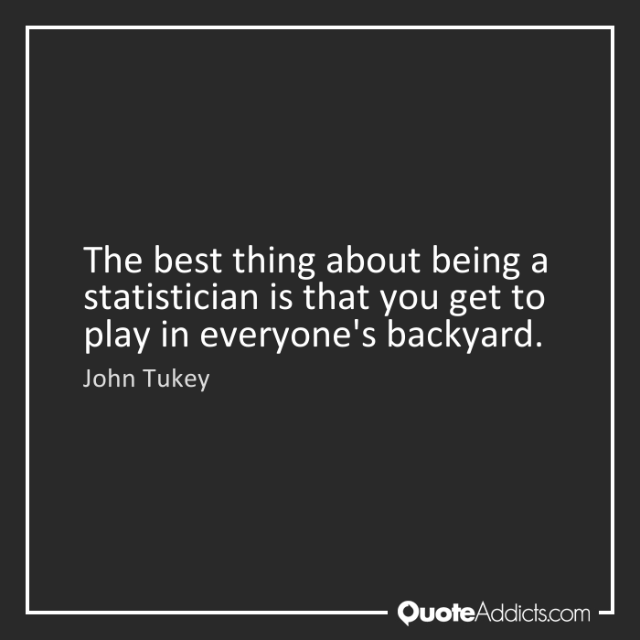

Slide 5
EDA Benefits - Example
Cook et al (2007) analyzed the variables that best predict the tip that a dining party will give to the waiter. Measured values:
the tip amount
total bill
payer gender
smoking/non-smoking section
time of day
day of the week
size of the party
Notes:
Cook, D. and Swayne, D.F. (with A. Buja, D. Temple Lang, H. Hofmann, H. Wickham, M. Lawrence). Interactive and Dynamic Graphics for Data Analysis: With R and GGobi. Springer. ISBN 9780387717616.

Slide 6
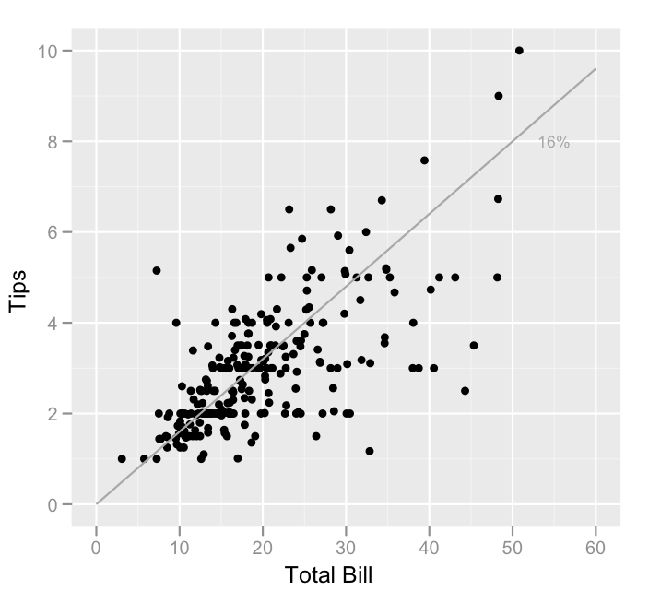
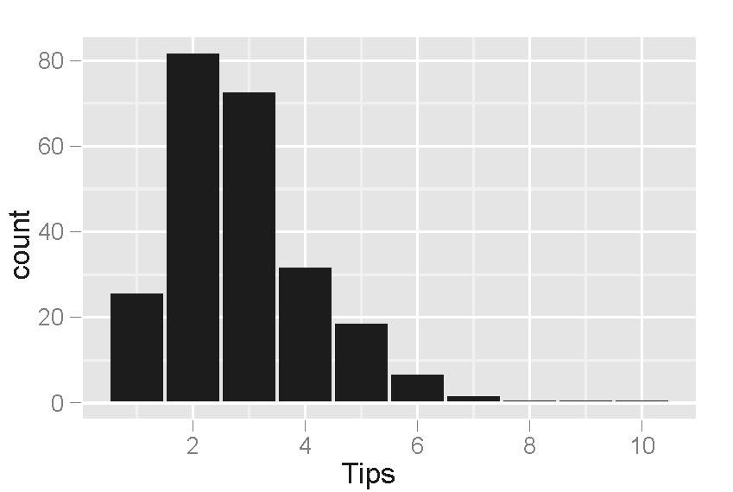
Derived Model:
tip_rate = 0.18 - 0.01×party_size

Slide 7
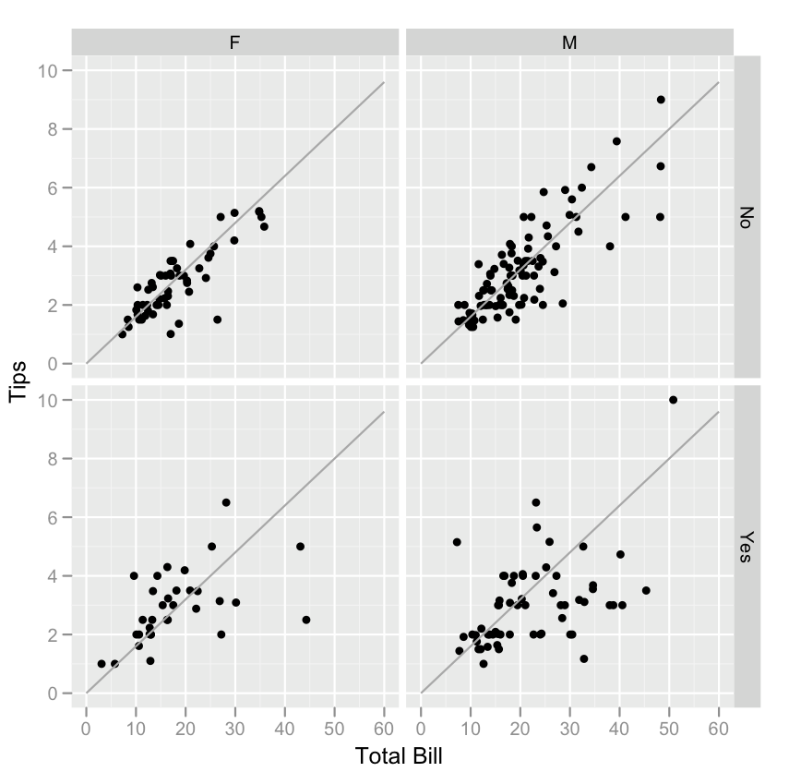
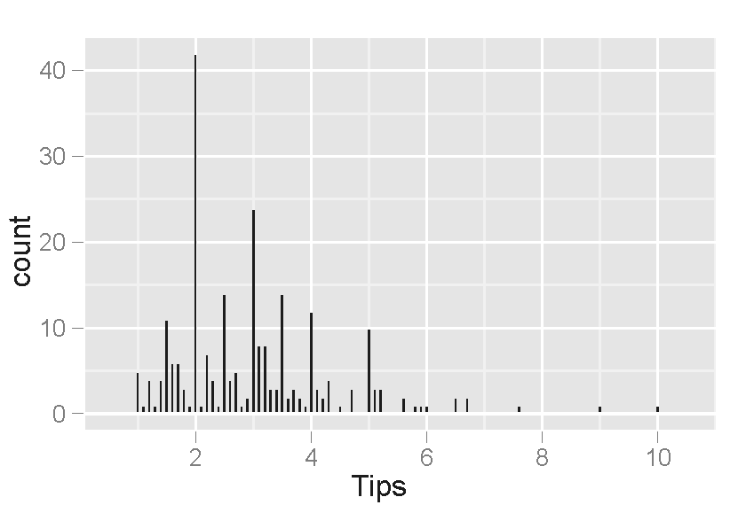
EDA Shows Additional Hypotheses

Slide 8
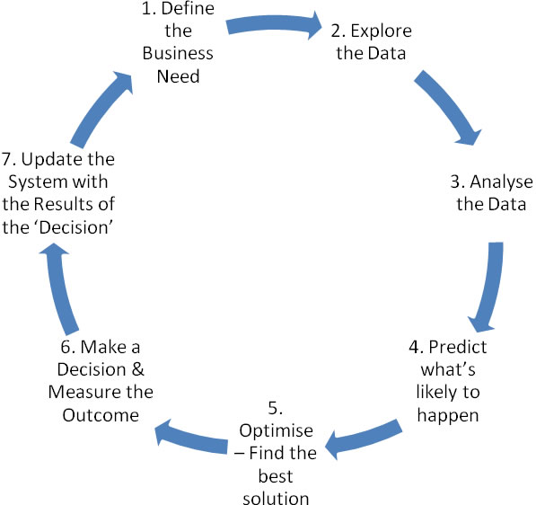
eda pROCESS
Notes:
Source: https://carolhargreaves.com/2013/08/

Slide 9
Maximize insight into a data set and into the underlying structure of a data set
a good-fitting, parsimonious model
a list of outliers
a sense of robustness of conclusions
estimates for parameters
uncertainties for those estimates
a ranked list of important factors
conclusions as to whether individual factors are statistically significant
optimal settings
Get a "feel" for the data

Slide 10
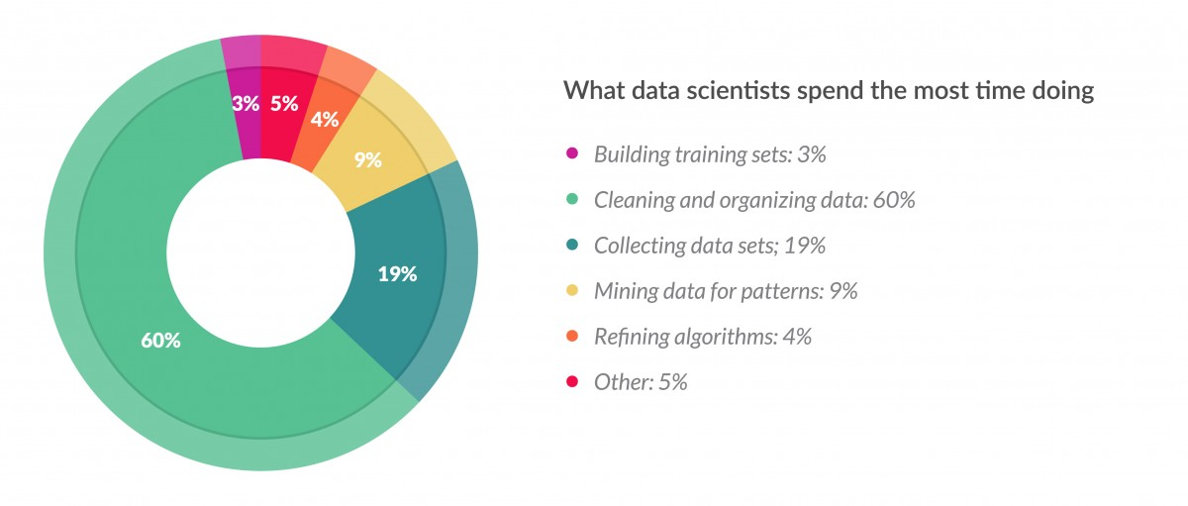
The Importance of Data Cleaning
Notes:
Source: whatsthebigdata.com

Slide 11
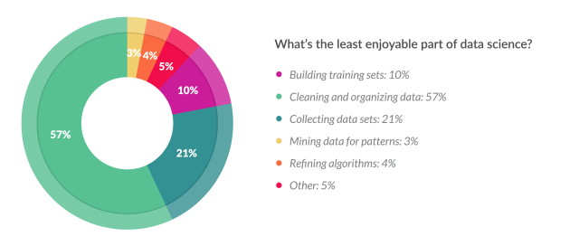
The Neglect of Data Cleaning

Slide 12
Tidy Data

Slide 13
Tidy Data
Happy families are all alike; every unhappy family is unhappy in its own way — Leo Tolstoy
In tidy data:
Each variable forms a column.
Each observation forms a row.
Each type of observational unit forms a table.

Slide 14
5 Most Common Problems with Messy Data
Column headers are values, not variable names
Multiple variables are stored in one column
Variables are stored in both rows and columns
Multiple types of observational units are stored in the same table
A single observational unit is stored in multiple tables

Slide 15
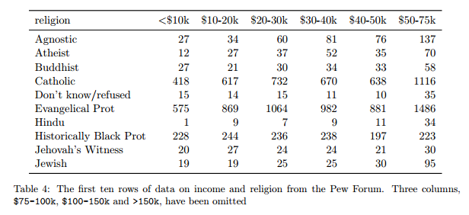
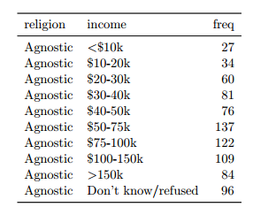
Column headers are values, not variable names

Slide 16
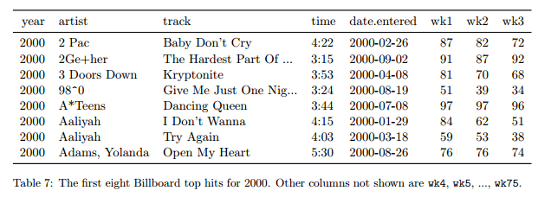
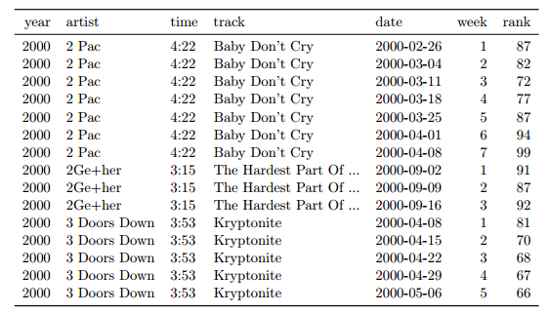
Messy
Tidy

Slide 17
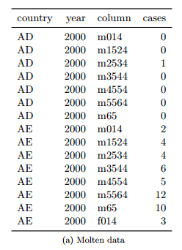
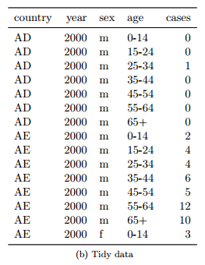
Variables are stored in both rows and columns

Slide 18
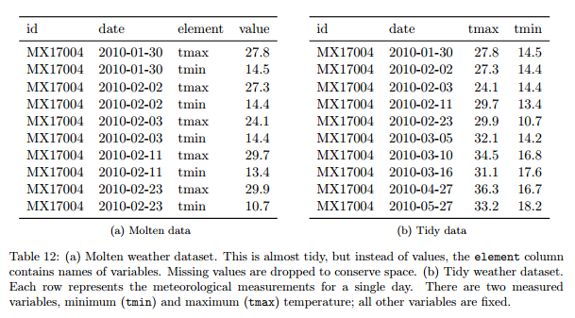
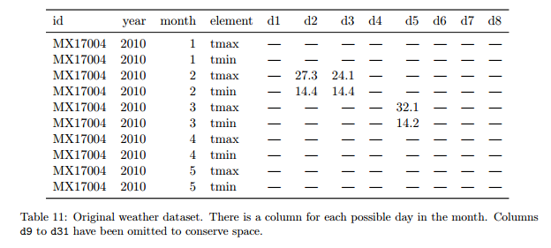
Multiple types in one table

Slide 19
Homework
Perform EDA of the OkCupid dataset https://github.com/rudeboybert/JSE_OkCupid
Use Jupyter Notebook, combining markdown, code and graphs
Use appropriate headings and sections
Choose the best graph for the job
Explain what the graph shows
Submit notebook as a Pull Request. Name the file YOURID_YOURNAME_EDA_OkCupid.ipynb
Read Example Machine Learning Notebook until Step 5 (Classification) – not including
Read Visualization with Seaborn

